Slide 1
Introducing The ARMORY System

Slide 2
Scott Coons Owner, Designer The Armory System evolved from the need for a way to mount weapons inside a concealment headboard, which was in line to be the first product offered by Castle Tactical.

Slide 3
The concealment headboard was presented to the public at the NRA show in April 2023. It was well received, but people were far more interested in the slotted panels displayed as a secondary product.

Slide 4
The decision was made to pivot to the Armory product and develop it first. It is now ready for production.

Slide 5
The foundation of the armory system is a set of 14-gauge steel panels, sized in increments of 16” wide and 12” tall. These measurements exploit standard stud spacing of 16” found in most homes.

Slide 6
The panels can be arrayed in any configuration to fit into almost any wall space. The slotted pattern maintains proper spacing throughout the installation so accessories may span multiple panels.

Slide 7
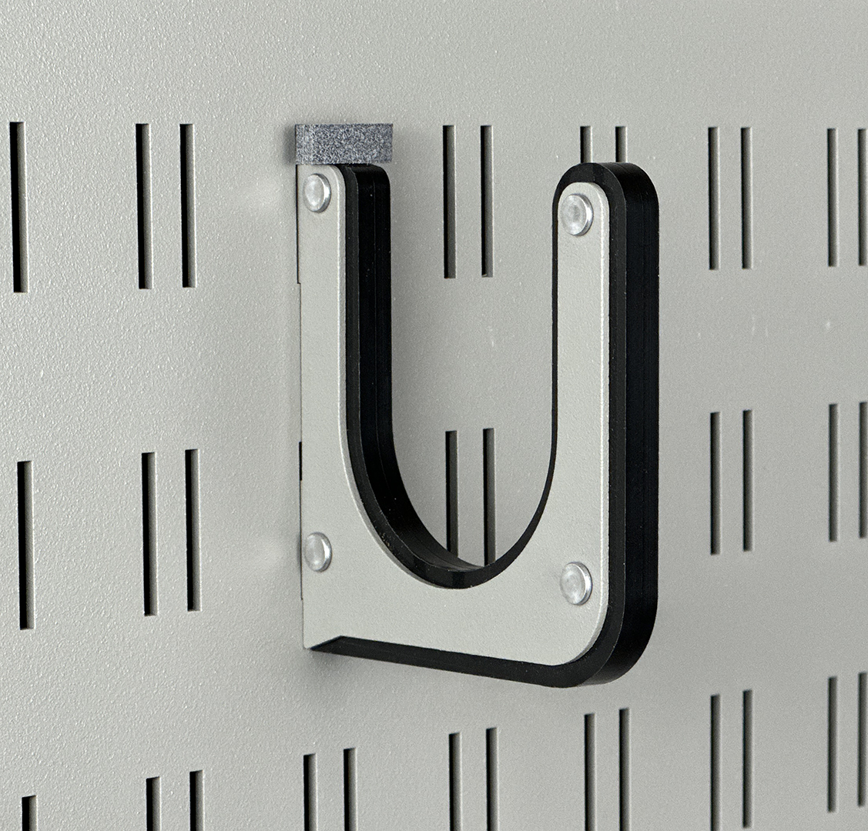
A wide array of attachment accessories makes mounting your firearms easy, and with our patent-pending tool-free securing plug, you can relocate accessories very easily.

Slide 8
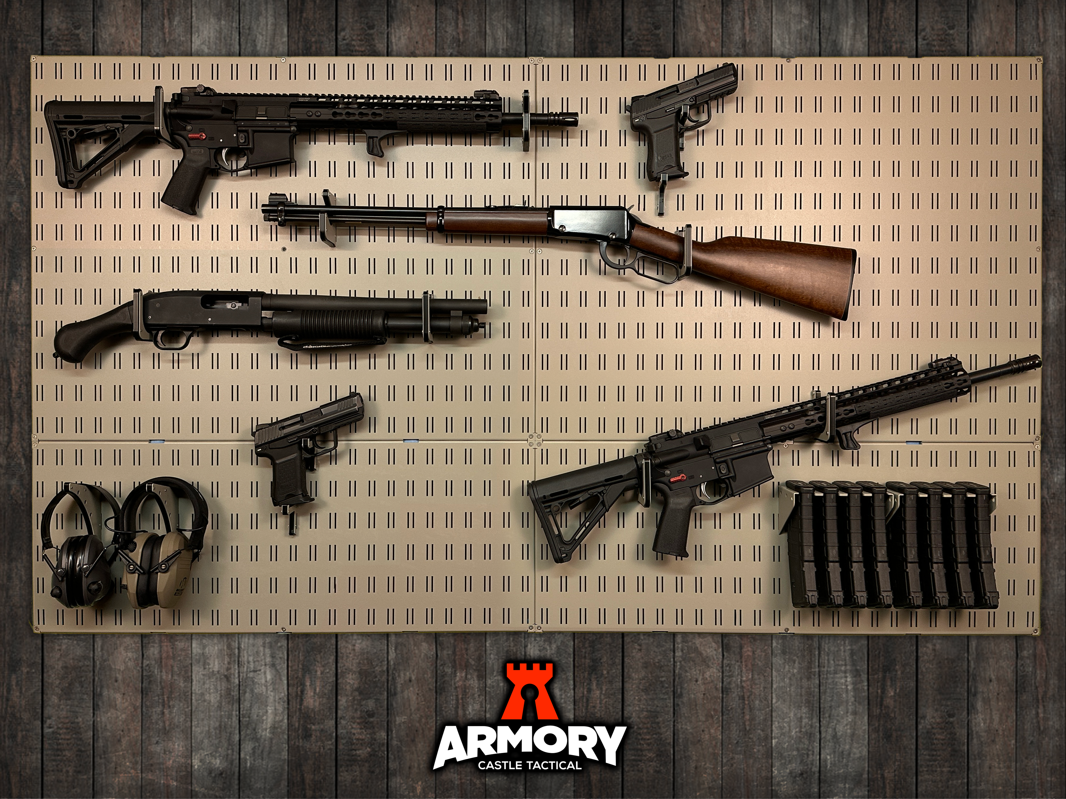
The Armory System can be used for display purposes, sized for a particular wall, with room to grow. Overall size: 64”W x 36”H

Slide 9
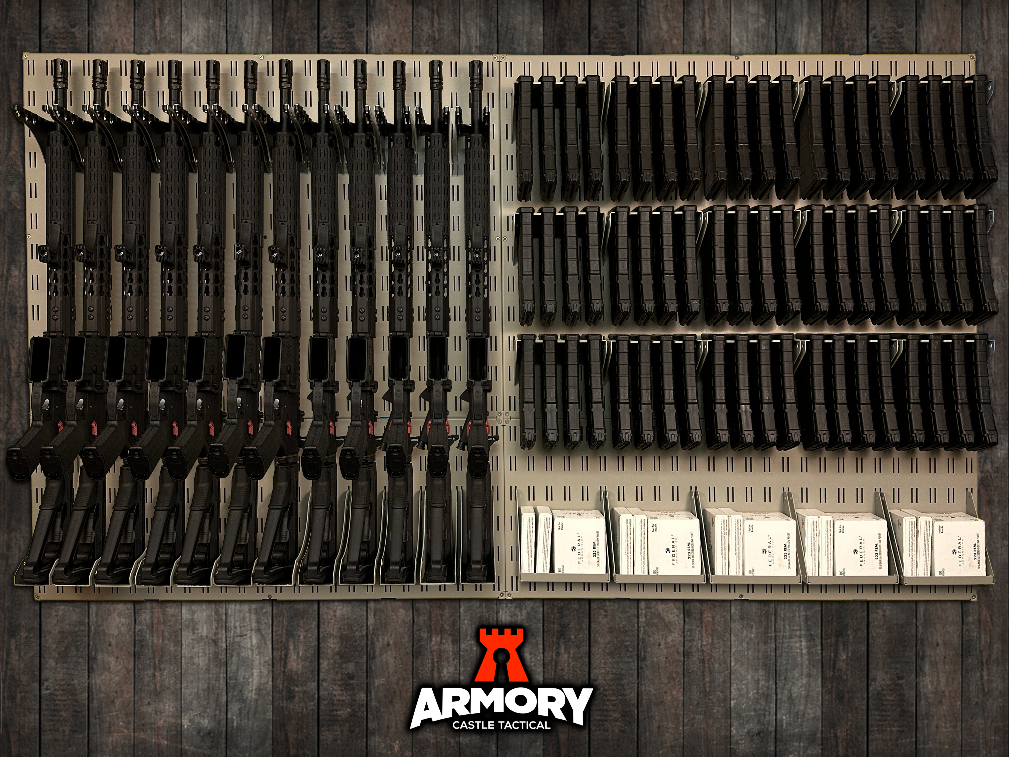
It can also be used for efficient storage. Armory panels have 30% more connect points than G********h Overall size: 64”W x 36”H

Slide 10
Accessories will constantly be added, and requests for specific accessories will be considered if it would be popular with consumers.

Slide 11
In fact, we are already considering offering products for other purposes, such as: a Fishing Equipment Storage a Sporting Goods Storage a Wine Racks a Musical Instrument Display

Slide 12
https://www.CastleTactical.com/digital-assets/ For access to digital assets for print and web use:

